Slide 1
Microsoft Azure Notification Hub
Implementation of Azure Notification Hub using Spring Boot Application

Slide 2
What are Azure Notification Hubs?
Azure Notification Hubs provide an easy-to-use and scaled-out push engine that enables you to send notifications to any platform (iOS, Android,Windows,etc.) from any back-end (cloud or on-premises). Notification Hubs works great for both enterprise and consumer scenarios. Here are a few example scenarios:
Send breaking news notifications to millions with low latency.
Send location-based coupons to interested user segments.
Send event-related notifications to users or groups for media/sports/finance/gaming applications.
Push promotional contents to applications to engage and market to customers.
Notify users of enterprise events such as new messages and work items.

Slide 3
What are push notifications?
Push notifications area form of app-to-user communication where users of mobile apps are notified of certain desired information, usually in a pop-up or dialog box on a mobile device. Users generally choose to view or dismiss the message;choosing the former opens the mobile application that communicated the notification. Some notifications are silent - delivered behind the scenes for the app to process and decide what to do. Push notifications are vital for consumer apps in increasing app engagement and usage,and for enterprise apps in communicating up-to-date business information. It's the best app-to-user communication because it is energy-efficient for mobile devices, flexible for the notifications senders,and available when corresponding applications are not active.

Slide 4
How to Azure Notification Hub works?
Notification Hubs eliminates all complexities associated with sending push notifications on your own from your app backend. Its multi-platform, scaled-out push notification infrastructure reduces push-related coding and simplifies your backend.With Notification Hubs, devices are merely responsible for registering their PNS handles with a hub, while the backend sends messages to users or interest groups.

Slide 5
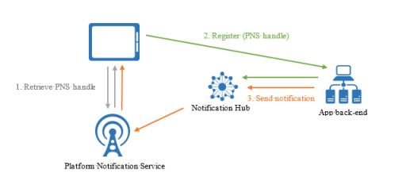
Azure Notification Hub Workflow

Slide 6
Azure Notification Hub Advantages
Cross platforms
Cross backends
Rich set of delivery patterns
Rich telemetry
Scalability
Security

Slide 7
Implementation of Azure Notification Hub
We have to implement the following steps in order to implement a POC of Azure Notification Hub using Spring Boot Application and these are:
Create an Azure Notification Hub in the Azure Portal
Integrating our Notification Hub with Platform Notification Services like APNS(Apple Push Notification Service), FCM(Firebase Cloud Messaging Service), WNS(Windows Notification Service) etc.
Creating a Android project in Android Studio and integrating it with Google Firebase Project.
Creating a Spring Boot Application for Sending Notification
Sending Notification using Azure Notification Hub to a user.

Slide 8
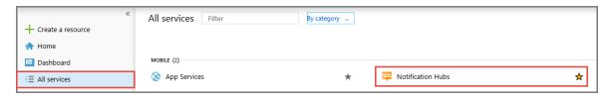
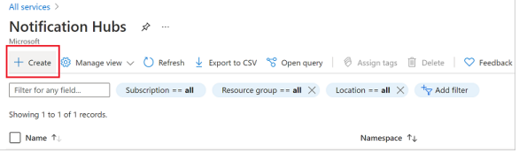
Create an Azure notification hub in the Azure portal
Create a namespace and a notification hub.
On the Notification Hubs page, select Create on the toolbar

Slide 9
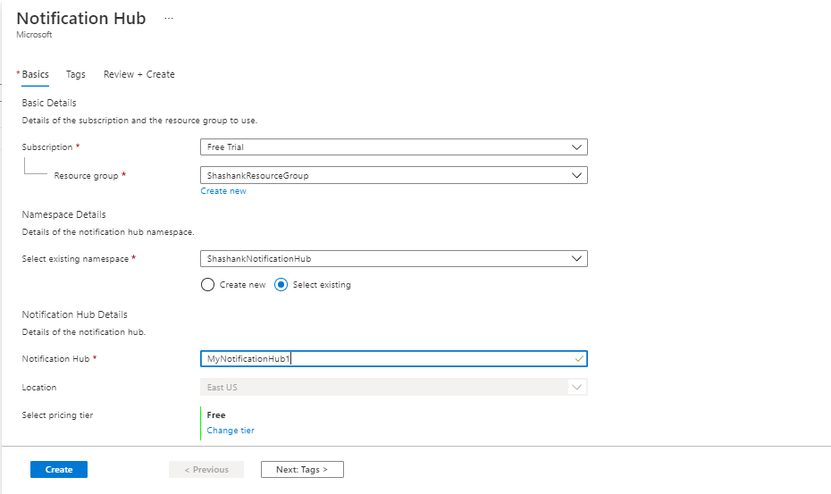
3. In the Basics tab on the Notification Hub page we have to enter the following details as shown in below snippet.

Slide 10
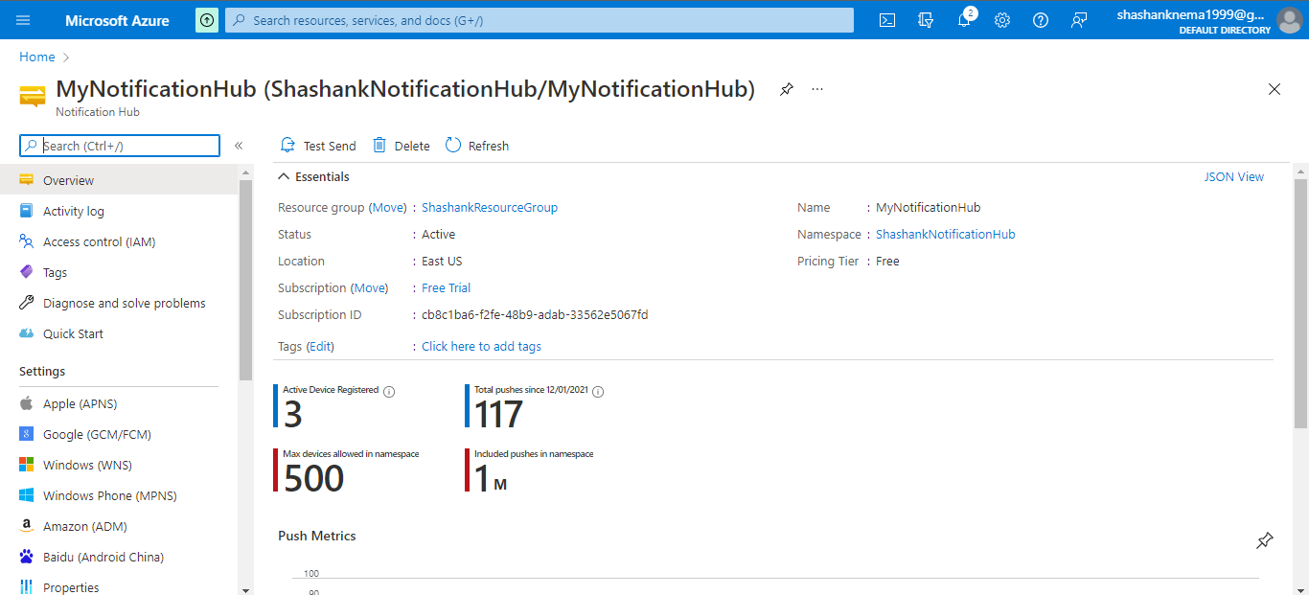
4. After successful creation of Azure Notification Hub it will be shown as the following snippet shows below:

Slide 11
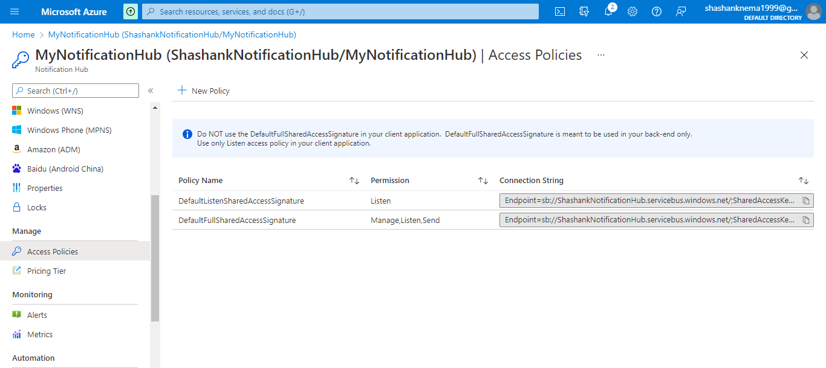
5. Select Access Policies from the list. Note that the two connection strings are available to you. You'll need them later to handle push notifications.

Slide 12
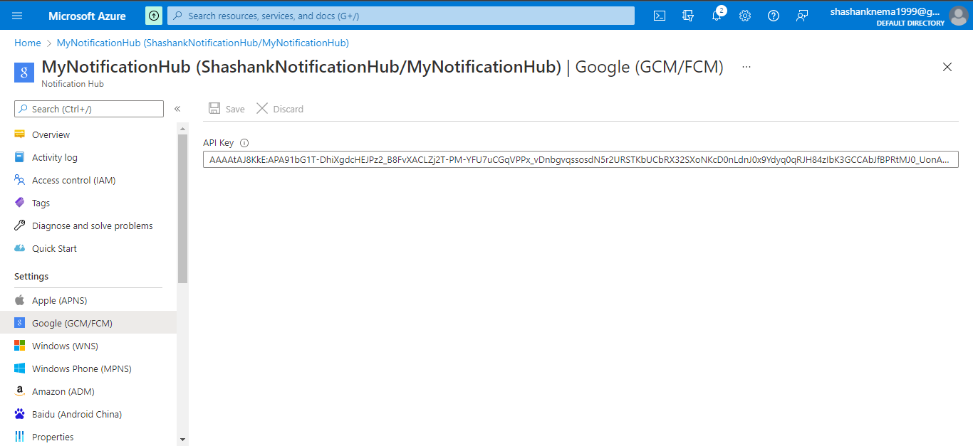
Integrating Azure Notification Hub with FCM
Adding a API key provided by Google Firebase Messaging Service to Azure Notification Hub so that our Notification hub can become integrated with Notification Hub. The following snippet shows how to add API key to Notification Hub:

Slide 13
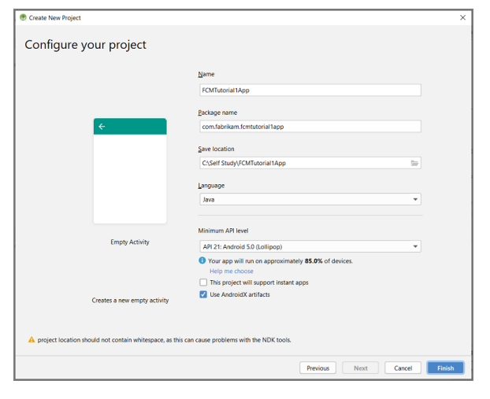
Creating a Android project in Android Studio and integrating it with Google Firebase Project
Create an Android Studio project and enter the following details as shown in below snippet:

Slide 14
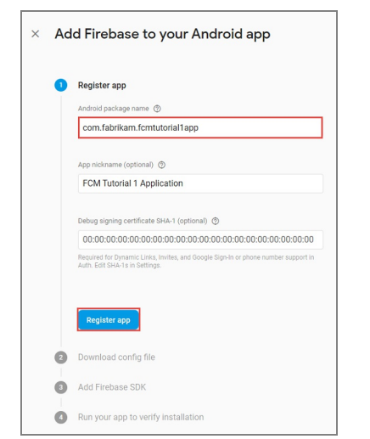
2. Create a Firebase project that supports FCM is shown in below snippet:

Slide 15
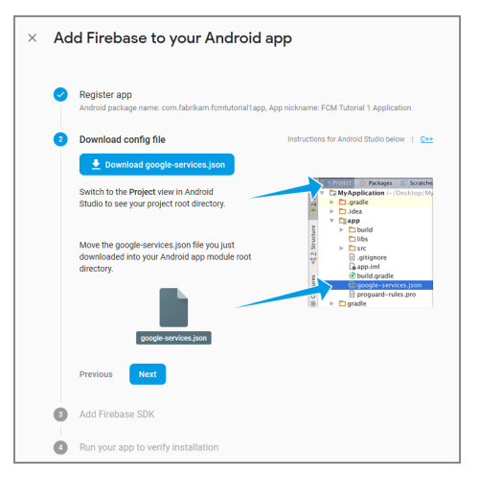
3. Integrating FCM project with our Android Studio Project by adding the google-services.json file in the root directory of our Android Studio Project is shown in snippet below:

Slide 16

Creating a Simple Android Application for receiving Notification
In the build.gradle file for the app,add the following lines in the dependencies section:
Add the following line to the end of the app-level build.gradle file after the dependencies section:

Slide 17
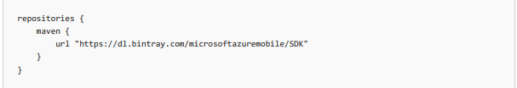
3. Add Azure Notification Hubs libraries. In the Build.Gradle file for the app,add the following lines in the dependencies section
4. Add the following repository after the dependencies section

Slide 18
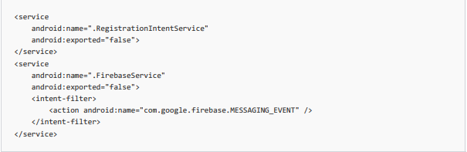

5. Update the Android Manifest.xml file
6. Add the following necessary FCM-related permissions below the <application> tag.

Slide 19
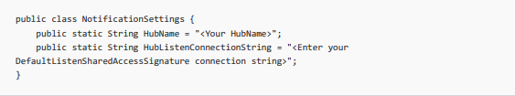
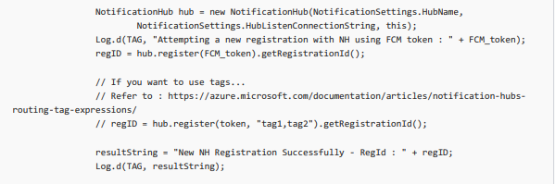
7. Creating a Configuration class for the use of Connection String and Hubname given by Azure Notification Hub is shown in below snippet:
8. Registering the device with a token generated by FCM with Azure Notification Hub:

Slide 20
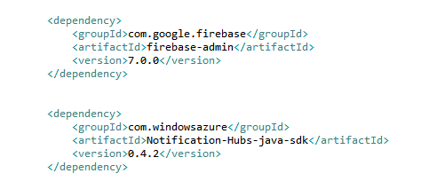
Creating a Spring Boot Application for Sending Notification
Creating a Spring boot Application in Spring Tool Suite/IntelliJ.
Add the following maven dependency in pom.xml file of the project is shown in the below snippet:

Slide 21

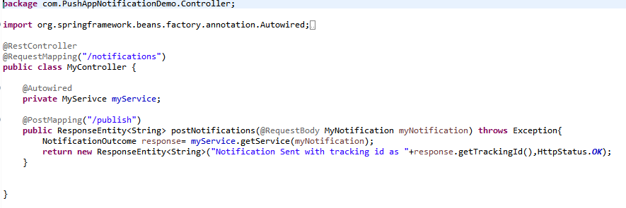
3. Creating a Notification hub bean with Connection String and HubName provided by Azure Notification Hub is shown below in the following snippet:
4. Creating a end point for handling the Notification send request is shown in below snippet:

Slide 22
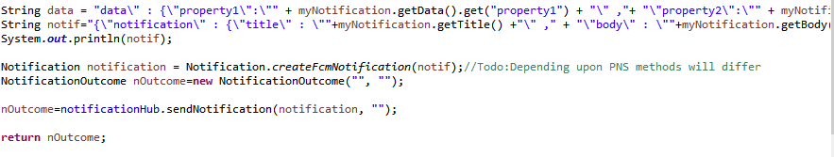
5. Sending Notification body to Azure Notification Hub from service layer of Spring boot Application is shown in below snippet:

Slide 23
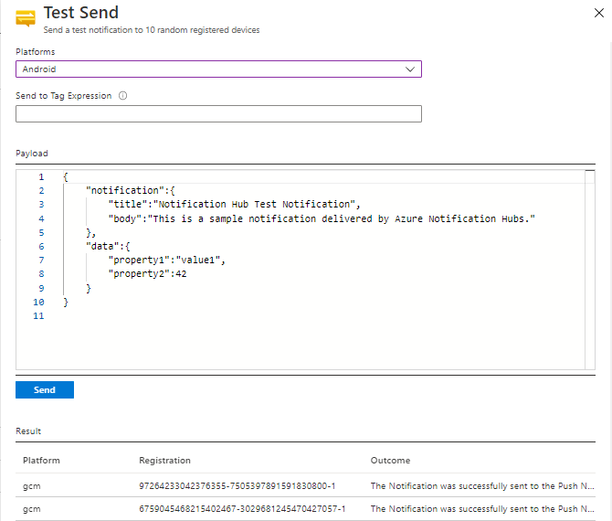
Sending Notification to User
Sending Test Notification from Azure Notification Hub Portal to Android Devices is shown below in the following snippet:

Slide 24
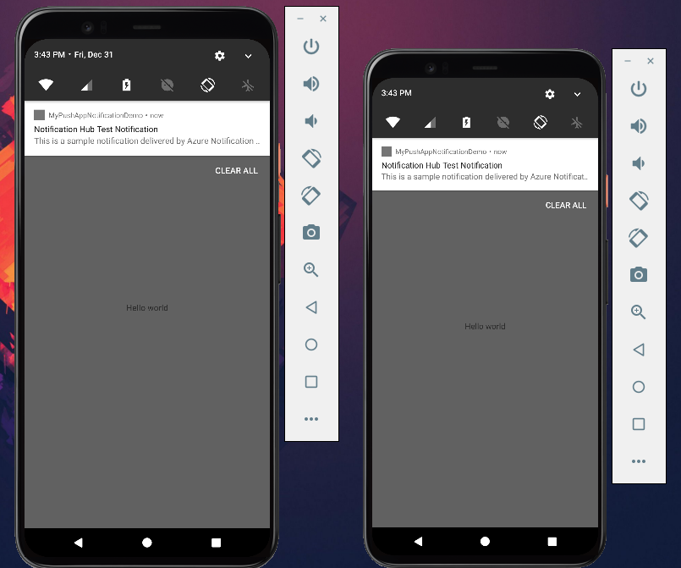
2. Notification Received by Android Devices is shown in below snippet:

Slide 25
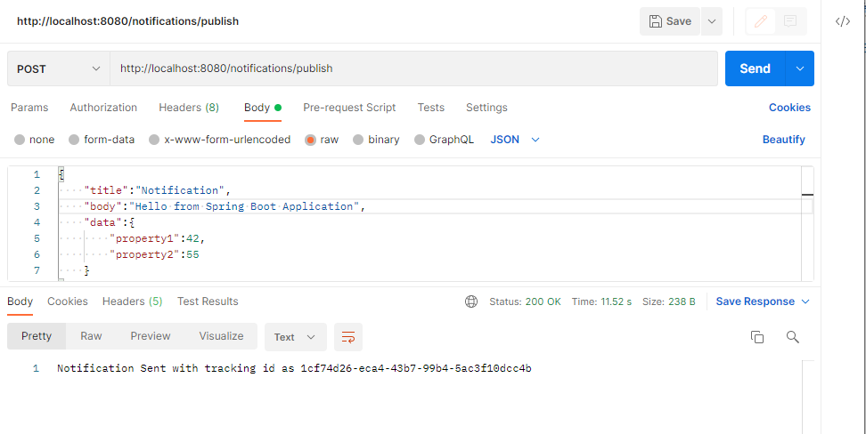
3. Sending Notification to Android Devices using Spring Boot Application is shown in below snippet:

Slide 26
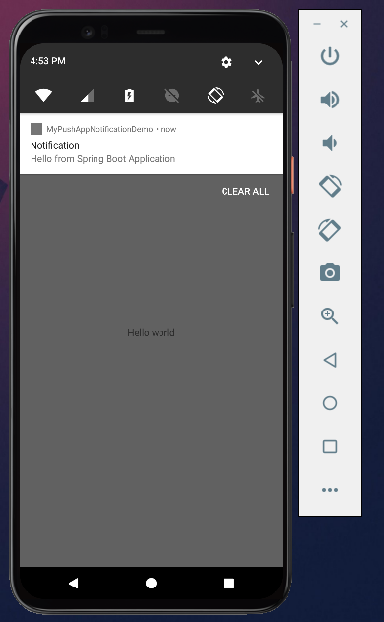
4. Receiving Notifications in Android Devices is shown below:

Slide 27
References
https://docs.microsoft.com/en-us/azure/notification-hubs/
https://k21academy.com/microsoft-azure/az-304/azure-notification-hub/

Slide 28
Thank You.

